Slide 1


Regular Expressions (RegEx)
Regular Expressions Language Syntax
SoftUni Team
Technical Trainers
Software University
http://softuni.bg

Slide 2
Table of Contents
Regular Expressions Syntax
Definition and Pattern
Predefined Character Classes
Quantifiers and Grouping
Lookbehind/Lookahead
Backreferences

Slide 3
Have a Question?
sli.do
#TECH-FUND

Slide 4
[A-Z]
Regular Expressions
Definition and Classes

Slide 5
What are Regular Expressions?
Regular expressions (regex)
Match text by pattern
Patterns are defined by special syntax, e.g.
[0-9]+ matches non-empty sequence of digits
[A-Z][a-z]* matches a capital + small letters
Play with regex live at: regexr.com, regex101.com

Slide 6
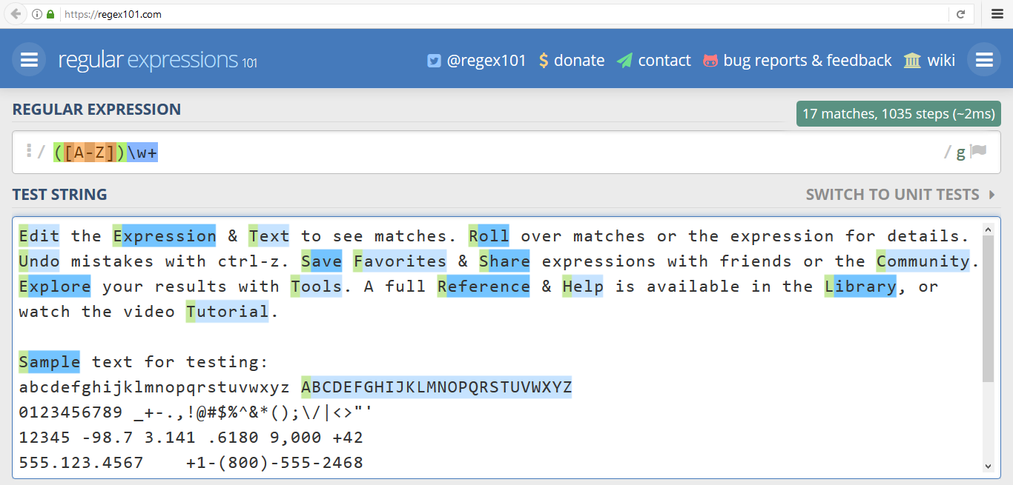
www.regex101.com
Live Demo

Slide 7
Regular Expression Pattern – Example
Regular expressions (regex) describe a search pattern
Used to find / extract / replace / split data from text by pattern
[A-Z][a-z]+ [A-Z][a-z]+
John Smith
Linda Davis
Contact: Alex Scott

Slide 8
Character Classes: Ranges
[nvj] matches any character that is either n, v or j
[^abc] – matches any character that is not a, b or c
[0-9] – character range: matches any digit from 0 to 9
node.js v0.12.2
Abraham
John is 8 years old.

Slide 9
Predefined Classes
\w – matches any word character (a-z, A-Z, 0-9, _)
\W – matches any non-word character (the opposite of \w)
\s – matches any white-space character
\S – matches any non-white-space character (opposite of \s)
\d – matches any decimal digit (0-9)
\D – matches any non-decimal character (the opposite of \d)

Slide 10
(\w+)
Quantifiers
Grouping

Slide 11
Quantifiers
* – matches the previous element zero or more times
+ – matches the previous element one or more times
? – matches the previous element zero or one time
{3} – matches the previous element exactly 3 times
\+\d*
+359885976002 a+b
\+\d+
+359885976002 a+b
\+\d?
+359885976002 a+b
\+\d{3}
+359885976002 a+b

Slide 12
Grouping Constructs
(subexpression) – captures the matched subexpression as numbered group
(?:subexpression) – defines a non-capturing group
(?<name>subexpression) – defines a named capturing group
\d{2}-(\w{3})-\d{4}
22-Jan-2015
^(?:Hi|hello),\s*(\w+)$
Hi, Peter
(?<day>\d{2})-(?<month>\w{3})-(?<year>\d{4})
22-Jan-2015

Slide 13
Problem: Match All Words
Write a regular expression in www.regex101.com that extracts all word char sequences from given text
_ (Underscores) are also word characters!
_|Underscores|are|also|word|characters

Slide 14
Problem: Match Dates
Write a regular expression that extracts dates from text
Valid date format: dd-MMM-yyyy
Examples: 12-Jun-1999, 3-Nov-1999
I am born on 30-Dec-1994.
My father is born on the 9-Jul-1955.
01-July-2000 is not a valid date.

Slide 15
Problem: Email Validation
Write a regular expression that performs simple email validation
An email consists of: username @ domain name
Usernames are alphanumeric
Domain names consist of two strings, separated by a period
Domain names may contain only English letters
Valid:
Invalid:
valid123@email.bg
invalid*name@emai1.bg

Slide 16
?<=
Lookahead and Lookbehind
Positive and negative

Slide 17
Lookahead
Positive lookahead
Find expression A where expression B follows
Negative lookahead
Find expression A where expression B does not follow
A(?=B)
[a-z]+(?=\d+)
A(?!B)
[a-z]+(?!\d+)

Slide 18
Lookbehind
Positive lookbehind
Find expression A where expression B precedes
Negative lookbehind
Find expression A where expression B does not precede
(?<=B)A
(?<=\d)[a-z]+
(?<!B)A
(?<!\d)[a-z]+

Slide 19
\1
Backreferences
Numbered Capturing Group

Slide 20
Backreferences Match Previous Groups
\number – matches the value of a numbered capture group
<(\w+)[^>]*>.*?<\/\1>
<b>Regular Expressions</b> are cool!
<p>I am a paragraph</p> … some text after
Hello, <div>I am a<code>DIV</code></div>!
<span>Hello, I am Span</span>
<a href="https://softuni.bg/">SoftUni</a>

Slide 21

Live Exercises

Slide 22

Summary
…
…
…
Regular expressions describe patterns for searching through text
Define special characters, operators and constructs for building complex pattern
Can utilize character classes, groups, quantifiers and more

Slide 23
https://softuni.bg/trainings/courses

Slide 24













SoftUni Diamond Partners

Slide 25





SoftUni Organizational Partners

Slide 26




Trainings @ Software University (SoftUni)
Software University – High-Quality Education and Employment Opportunities
softuni.bg
Software University Foundation
http://softuni.foundation/
Software University @ Facebook
facebook.com/SoftwareUniversity
Software University Forums
forum.softuni.bg

Slide 27

License
This course (slides, examples, demos, videos, homework, etc.) is licensed under the "Creative Commons Attribution-NonCommercial-ShareAlike 4.0 International" license

